Slide 1
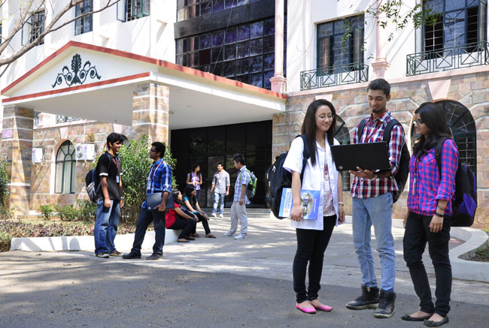

CSB4301 – Theory of Computation
B.Tech – IVth Semester
Mr. D.S.John Deva Prasanna AP(SG) & Ms.Vanathi, AP(SS)
Department of Computer Science and Engineering

Slide 2
Theorems and Observations
Theorems
Theorems generally are statements that is true for infinite number of cases.
Strict mathematical convention will only dignify a statement as a theorem if it has infinite number of cases.
Statements
A statement which applies to only a finite number of values for its parameters then it is called as observations

Slide 3

Inductive Proofs
Induction on Integers
If we are given a statement S(n) about an integer ‘n’ then the common approach is
Prove the basis i.e Prove the statement is true for S(i) for i=0 or i=1
Prove the inductive step :
Assume a number n>= i where i is the basis integer.
Show that of S(n) then S(n+1) (i.e Show that the statement is true for i=n and for i=n+1)
sometimes we will also use if S(n-1) then S(n) (i.e Show that the statement is true for i=n-1 and for i=n)

Slide 4
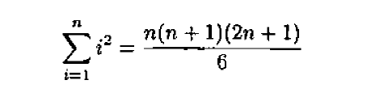

Prove this by induction
Step 1 : Prove the Basis here we pick the value of basis as ‘0’.
Substituting n with 0 in above equation will result in ‘0’

Slide 5
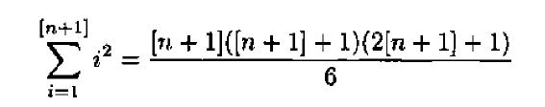
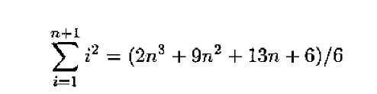
Inductive Proof continued
--
Now substitute n+1 in the place of ‘n’
Then the result will be

Slide 6
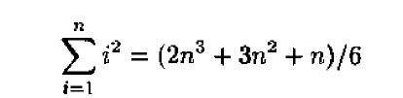
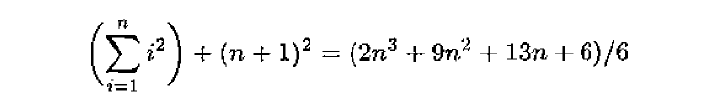
Induction Proof ....
But if we simplify the equation for n=n then we will get
Now we try to deduce S(n+1) in terms of S(n) and prove that the theorem is true for all values of n
Which is nothing but

Slide 7



Proof by induction
Here the basis value of ‘x’ should be ‘4’
If we replace ‘x’ with ‘x+1’ we will get
We will rewrite the LHS of the above equation as

Slide 8




Proof by induction
We will try to write
We will use the transitivity to write
We shall rewrite the above equation as
Since minimum value of ‘x’ is ‘4’ the LHS will be 4 and RHS will be 2.25. HENCE PROVED

Slide 9
Structural Induction
In automata theory there are several recursively defined structures and hence we concentrate on structural Induction too.
Here Complex structures are defines in terms of previously defined structures.
Like numerical induction this too has basis case.

Slide 10
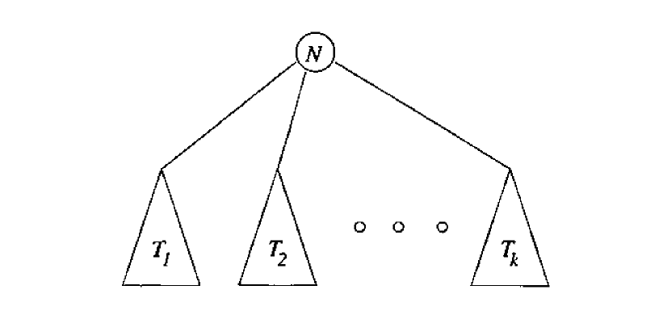
Structural Induction of a Tree
Here is a recursive definition of a tree.
Bases – a single node is tree and that node is the root of the tree.
Induction – if T1, T2, T3...Tk Are individual trees then we can build a new tree as follows
Begin with a new node N, which is the root of the tree.
Add copies of trees T1, T2, T3...Tk
Add edges from root node N to T1, T2, T3...Tk

Slide 11
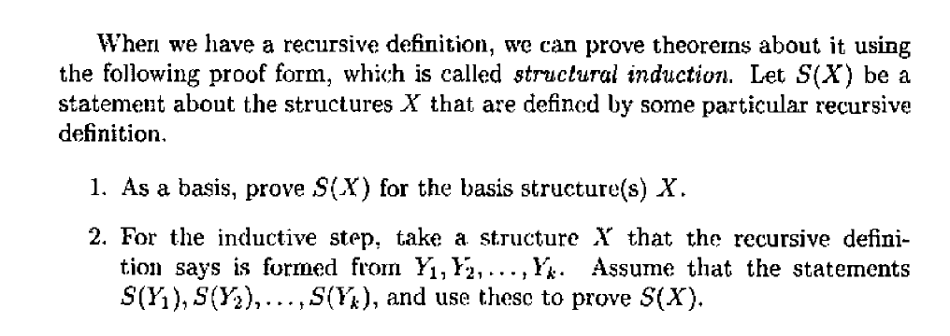
Structural Induction

Slide 12
Structural Induction Theorem: Every tree has one more node than its edges
Let T be tree built by induction by connecting the node ‘N’ (root node) with the Trees
T₁, T₂,T₃,.. T_{k}
We know every tree T_{i} has n_{i} nodes and e_{i} edges
Here n_{i}= e_{i}+1
Hence we will have number of edges as
K+e₁+ e₂+ e₃+... e_{k}
Now the no of nodes in every tree is one more that the edges, Hence
1+( e₁+1)+ ( e₂+1)+(e₃+1)... ( e_{k}+1)
After simplification the above case will be
K+1+e₁+ e₂+ e₃+... e_{k --------------------} (K+1)+e₁+ e₂+ e₃+... e_{k}

Slide 13
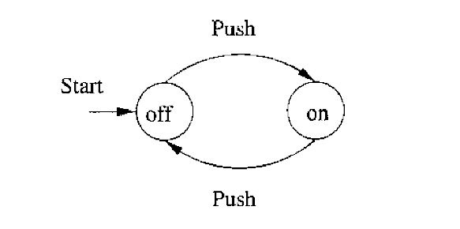
Mutual Induction
c
Sometimes single statement may not be sufficient to prove a statement, hence we have to rely on more that one statement S₁(N), S₂(N) , S₃(N)
This is similar to combining statements with a logical ‘and’.
S₁(N)- The automaton will be in state off after ‘n’ pushes if and only if ‘n’ is even.
S₂(N)- The automaton will be in state on after ‘n’ pushes if and only if ‘n’ is odd.

Slide 14
Thank You

